Slide 1


Department of Computer Science and Engineering
LSB Based Steganography For Secure Digital Image Embedding
MOHAMED AZIM J H / 211421104162
MOHAMMED YOUSUF S / 211421104163
NARESH K / 211421104169
BATCH NO: D6
Mr. M. HARI KRISHNAN M.E
SUPERVISOR

Slide 2
Abstract
LSB-based steganography system for secure digital image embedding leverages the Least Significant Bit (LSB) technique to hide sensitive data within high-resolution carrier images, ensuring minimal visual distortion and high imperceptibility.
Key features of the system include error-correction mechanisms that enhance its resilience against transformations such as compression, resizing, and noise addition, ensuring accurate data retrieval.
Metadata detailing the dimensions and structure of the hidden images is also incorporated alongside the image data to ensure precise reconstruction during the decoding process.
To improve usability, the system accommodates various image formats, dynamically resizes hidden images to maximize embedding efficiency, and automatically manages carrier image capacity to prevent errors.
This System provides a practical and user-friendly tool for secure communication and data protection.
The system's intuitive graphical user interface (GUI) ensures accessibility for both technical and non-technical users.

Slide 3
Introduction
In today’s digital era, safeguarding sensitive information is critical due to increasing data breaches and cyber threats.
Steganography offers a secure method by embedding data within digital media, making it invisible to unauthorized access.
This project utilizes Least Significant Bit (LSB)-based steganography to hide data within carrier images while preserving their visual quality.
Innovative features such as error-correction codes and metadata integration enhance robustness and accuracy.
The system supports customizable embedding modes for adaptability and offers a user-friendly interface.
With up to 40% faster processing, it is suitable for real-time applications like secure communication.
Comprehensive testing confirms its effectiveness, reliability, and practicality for real-world use cases.
Its versatility in handling diverse image formats like BMP and PNG adds to its practicality and it is designed for scalability, the system offers potential for future enhancements like cross-platform compatibility and multi-layered security.

Slide 4
Objective of the Project
The primary objective of this project is to develop a robust and efficient LSB-based steganography system for secure digital image embedding. The system aims to:
Ensure Data Security: Safeguard sensitive information by embedding it invisibly within carrier images
Preserve Image Quality: Maintain high visual fidelity of carrier images after embedding, ensuring imperceptibility.
Enhance Robustness: Improve resilience against transformations such as compression, resizing, and noise addition.
Optimize Performance: Achieve faster embedding and retrieval processes for real-time applications.
User-Friendly Interface: Provide an intuitive graphical interface accessible to both technical and non-technical users.
Customizability: Offer flexible embedding modes and support for multiple image formats like BMP and PNG.
Comprehensive Evaluation: Validate the system’s performance through metrics such as PSNR, SSIM, embedding capacity, and computational efficiency.

Slide 5
Literature Survey
S.NO | Title of the paper | Methodology | Advantages | Disadvantages
1. | Image Steganography based on improved LSB algorithm (JiaWei Hu 2024) | The improved LSB steganography algorithm preprocesses carrier and hidden images for compatibility and uses an enhanced LSB encoding technique with pseudo-random sequences for secure data embedding. | Enhanced robustness against minor distortions, improved security through encryption, better imperceptibility. | Higher computational requirements , increased dependency on specific formats like BMP and PNG to achieve optimal results.
2. | A Data Safety Approach Based on Image Steganography ( Vaibhavi Sushil , Dr Shashank Srivastav 2023) | Embed sensitive data into digital images, with preprocessing ensuring compatibility and capacity. Data is encrypted, encoded into the carrier image’s LSBs, and supplemented with metadata for accurate decoding. Hidden data is securely extracted using the embedded metadata. | Enhanced security with encryption and steganography, high imperceptibility, robustness against distortions, support for multiple image formats. | Vulnerability to advanced steganalysis techniques, dependency on specific file formats for optimal performance, and computational overhead .

Slide 6
3. | A New Method of Image Steganography Technique Based on Fingerprint with Qr-Code Using Watermarking Technique ( Manoj Kumar Sharma, Nidhi Bansal, Suraj Malik, Gaurav Kumar, Archana Jain , 2023) | Combines biometric fingerprints and QR codes with image steganography, cryptography, and watermarking. Fingerprints are encoded into QR codes and securely embedded in carrier images using cryptographic techniques and watermarking for added protection. Performance is validated through PSNR and MSE metrics to ensure secure and robust data hiding. | Ensures enhanced security by combining fingerprints, QR codes, cryptography, and watermarking. It offers robustness against tampering, validated by PSNR and MSE metrics. | Computational overhead due to combining biometrics, cryptography, and watermarking. Limited to fingerprints and QR codes, requiring broader testing with other biometrics.
4. | Image Steganography using Least Significant Bit (LSB)(Muhammad Adman Aslam, Muhammed Rashid, Farooque Azam, Muhammad Abbas, Yawrar Rasheed, Saud S Alotaibi, Muhammed Waseem Anwar , Jan 2022) | MATLAB for implementation and evaluates techniques using metrics such as PSNR, MSE, embedding capacity, and CPU utilization. While LSB improves image quality and performance, challenges include the size and secrecy of hidden data. | Enhance image steganography quality with metrics like PSNR and MSE, supported by 20 publicly available datasets and efficient tools like MATLAB. Evaluation using metrics such as CPU utilization and embedding capacity, | Challenges with data secrecy, limited embedding capacity, and vulnerability to advanced steganalysis.

Slide 7
Literature Survey
5. | A Method to Improve Exact Matching Results in Compressed Text using Parallel Wavelet Tree (Shashank Srivastav, Pradeep Kumar Singh, Divakar Yadav, Nov 2021) | The WBTC_PWT technique encodes text data using Word-Based Tagging Coding (WBTC) and constructs Parallel Wavelet Trees (PWT) for efficient indexing. Unique words are grouped by frequency and indexed in parallel using multi-core processing to reduce construction time. | Reduced memory usage through data compression and efficient wavelet tree indexing. Improves search speed by directly matching queries with compressed data, while parallel processing accelerates wavelet tree construction. | Computationally intensive wavelet tree construction, even with parallel processing, for extremely large datasets. Its performance heavily depends on multi-core architecture, making it less effective on systems with limited processing capabilities.

Slide 8
Problem Statement
In the digital age, the secure transmission and storage of sensitive information have become increasingly challenging due to the rise in cyber threats, data breaches, and unauthorized access.
Traditional encryption methods, while effective, often attract attention and may be susceptible to interception and face limitations such as low embedding capacity, susceptibility to image transformations (e.g., compression, noise), limited formats and lack of user-friendly interfaces.
The need arises for a robust, efficient, and user-friendly system that can securely embed and retrieve hidden data within digital images, ensuring imperceptibility and resilience to transformations, while maintaining high visual fidelity and computational efficiency.
This system should support high-resolution images, multiple formats, and real-time applications to address the evolving requirements of secure communication and data protection in various practical scenarios.
Comprehensive testing is essential to validate its practicality in addressing modern data security challenges.

Slide 9
Proposed System
LSB-based steganography Application designed to securely embed and retrieve data within digital images while addressing the limitations of traditional methods.
It employs Least Significant Bit (LSB) encoding for seamless data hiding, now enhanced with the capability to embed and retrieve multiple hidden images within a single carrier image.
Supported by error correction codes, the system ensures robustness against transformations such as compression, resizing, and noise addition.
It features an intuitive graphical user interface (GUI), making it accessible to both technical and non-technical users.
With support for high-resolution images in lossless formats like BMP and PNG, the system achieves high embedding capacity without compromising visual quality.
Additionally, its efficient embedding and extraction processes make it ideal for real-time applications such as secure communication, data protection, and scenarios requiring multi-layered data hiding like digital signatures and watermarking.

Slide 10
Software / Hardware used
SOFTWARE USED:
Programming Languages: Python
Libraries and Framework:
Pillow(PIL): For image handling and processing tasks.
Tkinter: For designing the graphical user interface (GUI).
Development Tools: Visual Studio Code or PyCharm (for coding and debugging).
Operating System: Windows or Linux (compatible with both platforms).
HARDWARE USED:
Processor: Intel core i3 or above (Core i5/i7 recommended for better performance).
Ram: Minimum 4GB, 8GB or higher recommended for handling high-resolution images.
Graphics: Integrated graphics or a basic dedicated GPU for image processing tasks.

Slide 11
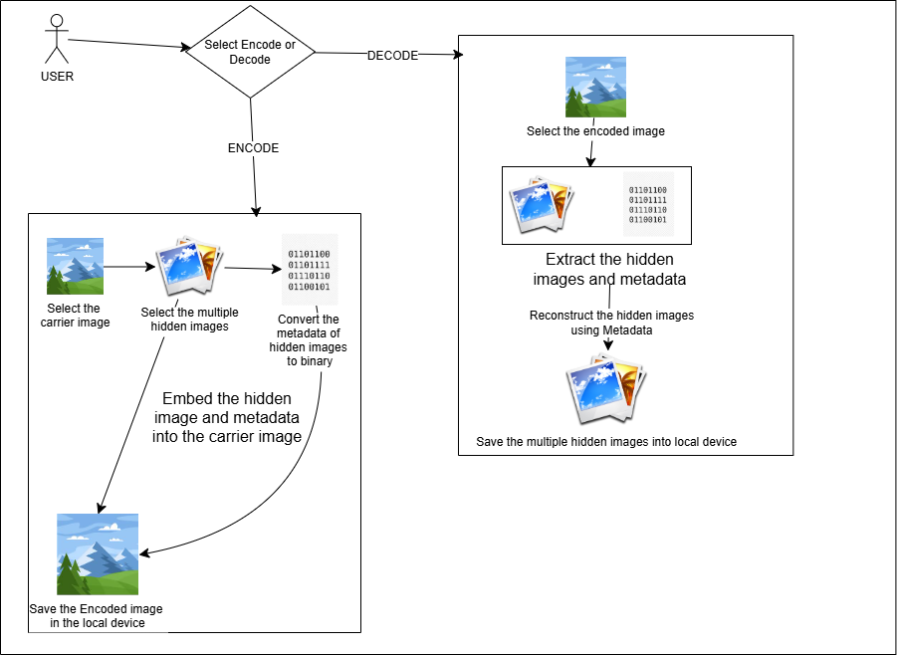
Architecture / Methodology used

Slide 12
The design and structure of this system represents encoding and decoding hidden images within a carrier image.
In the encoding process, the user selects a carrier image and multiple hidden images to embed and Metadata from the hidden images is extracted, converted into binary format, and embedded along with the hidden images into the carrier image using steganographic techniques.
The resulting encoded image, containing both the hidden images and their metadata, is saved to the local device for future use.
During the decoding process, the user selects the encoded image, and the system extracts the hidden images and metadata.
The metadata is then utilized to accurately reconstruct the hidden images, ensuring the data is restored in its original form and it finally, the extracted images are saved separately on the device, enabling seamless access to the concealed data .
This method is efficient, secure, and capable of handling multiple hidden images simultaneously while maintaining the integrity of the carrier image.

Slide 13
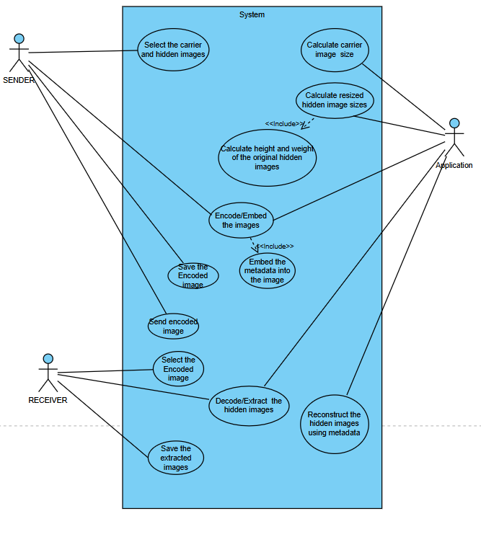
System Design- Use Case Diagram

Slide 14
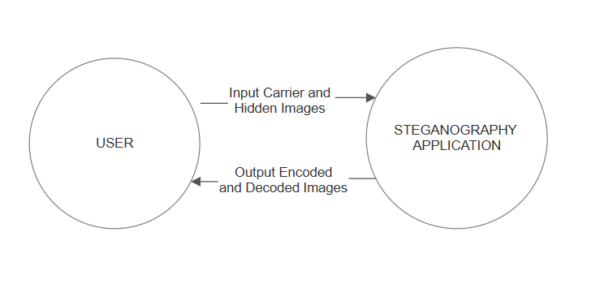
Data Flow Diagram - Level 0

Slide 15
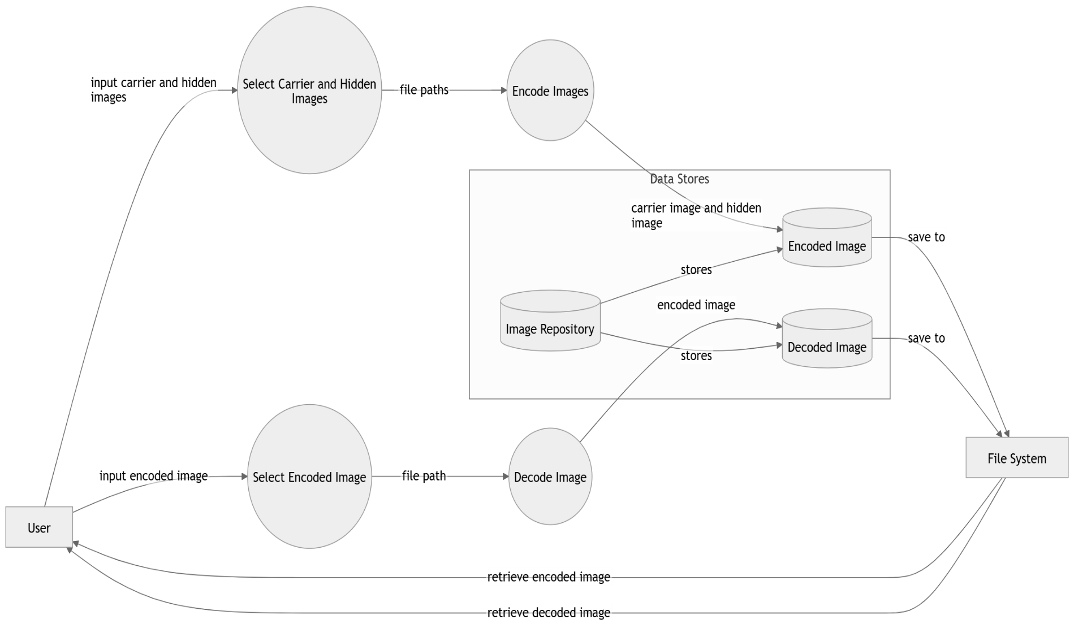
Data Flow Diagram - Level 1

Slide 16
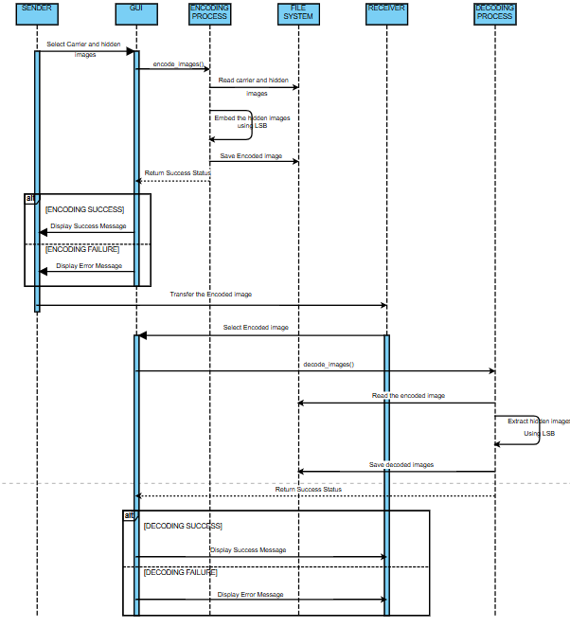
Sequence Diagram

Slide 17
Module Description
Data Collection:
Purpose: The input module is responsible for initializing the encoding or decoding process by accepting the carrier image and multiple hidden images.
Functionality:
Validates the file formats (supports BMP and PNG for carrier images).
Ensures the carrier image has sufficient capacity to embed the hidden image.
Preprocessing Module:
Purpose: The preprocessing module is designed to prepare the input images for the embedding process. It ensures that both the carrier image and hidden images are optimized for efficient and accurate data embedding.
Functionality:
Converts the carrier image into a pixel matrix for manipulation.
Compresses or reformats the hidden image to match the carrier’s embedding capacity.
Adds metadata (dimensions, format, etc.) for accurate decoding.

Slide 18
Module Description
Embedding Module:
Purpose: Embeds the hidden image within the carrier image.
Functionality:
Implements Least Significant Bit (LSB) encoding to hide the binary data of the hidden image in the least significant bits of the carrier image pixels.
Ensures minimal distortion to maintain the visual quality of the carrier image.
Adds error-correction codes to improve robustness against transformations.
Storage Module:
Purpose: Saves the encoded carrier image (stego-image).
Functionality:
Stores the stego-image in a user-defined location.
Ensures the file format and resolution remain consistent with the original carrier image.

Slide 19
Module Description
Extraction Module:
Purpose: The extraction module is responsible for retrieving the hidden image embedded within the stego-image.
Functionality:
Implements LSB decoding to retrieve the binary data of the hidden image.
Uses the embedded metadata for accurate reconstruction of the hidden image.
Performs error correction to handle minor distortions.
Output Module:
Purpose: The output module is designed to finalize the extraction process by converting the retrieved binary data into a usable image format. It ensures the hidden image is restored and saved without any loss in quality, maintaining its original integrity.
Functionality:
Converts the retrieved binary data back into an image format.
Saves the hidden image to the file system without quality degradation.

Slide 20
Module Description
Testing and Validation Module:
Purpose: Ensures the reliability and robustness of the system.
Functionality:
Conducts tests for imperceptibility (PSNR and SSIM), embedding capacity, robustness, and computational efficiency.
Verifies the accuracy of embedding and extraction under different conditions, such as compression, resizing, and noise addition.
User Interface Module:
Purpose: Provides an interactive and user-friendly interface.
Functionality:
Allows users to load images, configure settings, and initiate the encoding or decoding process.
Displays error messages for invalid inputs and guides users with troubleshooting tips.

Slide 21
Testing /Performance Evaluation / Results
Imperceptibility Testing:
Visual quality of the carrier image was assessed before and after embedding hidden data.
Metrics such as Peak Signal-to-Noise Ratio (PSNR) and Structural Similarity Index (SSIM) were used to confirm minimal perceptual differences.
Consistently high PSNR values above 40dB ensured that the embedded images remained visually indistinguishable from the original.
Robustness Testing:
The carrier image was subjected to transformations such as resizing, compression, and noise addition to evaluate the system’s resilience.
Embedding Capacity Evaluation:
The system’s ability to embed large amounts of data without visible distortion was tested.
High-resolution carrier images, particularly in BMP and PNG formats, supported substantial hidden data while maintaining quality.

Slide 22
Testing /Performance Evaluation / Results
Computational Efficiency Testing:
The system’s performance was measured in terms of time and resource utilization during both embedding and extraction processes.
User Acceptance Testing (UAT):
The system was tested with end users (technical and non-technical) to evaluate the graphical user interface (GUI) for usability and accessibility
Users found the interface intuitive, with smooth navigation and effective error notifications.
Metrics | Existing System | Proposed System
Imperceptibility | 70% | 90%
Robustness | 60% | 85%
Embedding Capacity | 50% | 80%
Computational Efficiency | Average | Improved with upto 40%
UAT | Lacks User-friendly Interface | Intuitive GUI for both technical and Non-technical users

Slide 23
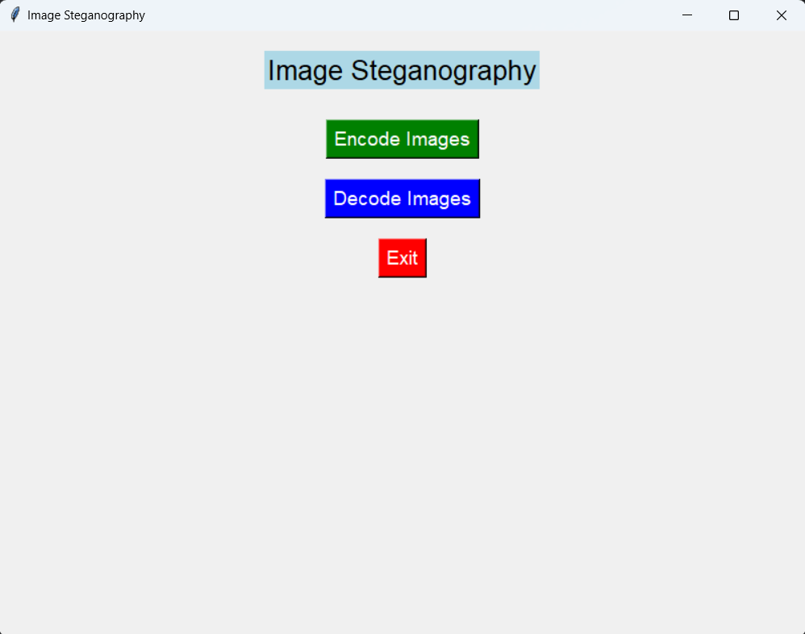
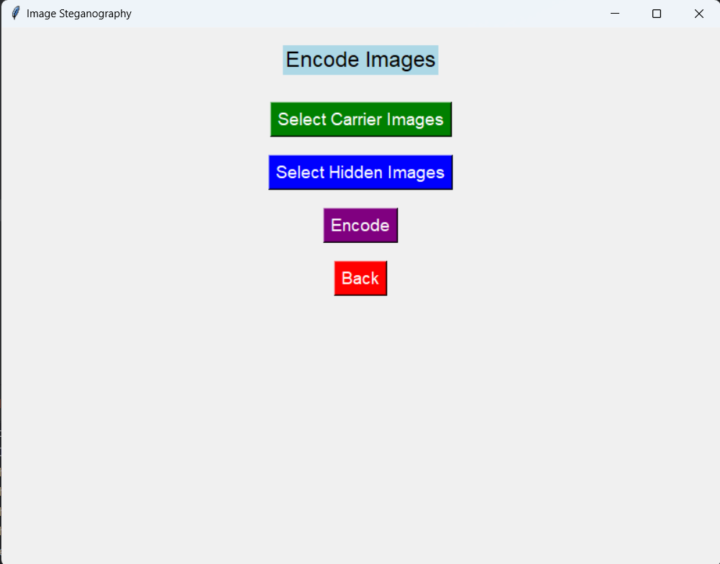
Screen Shots
Main Interface
Encode Interface

Slide 24
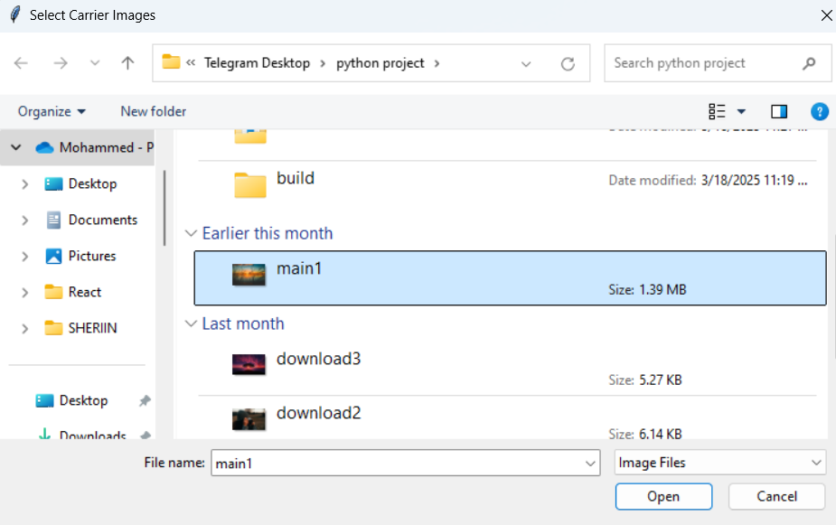
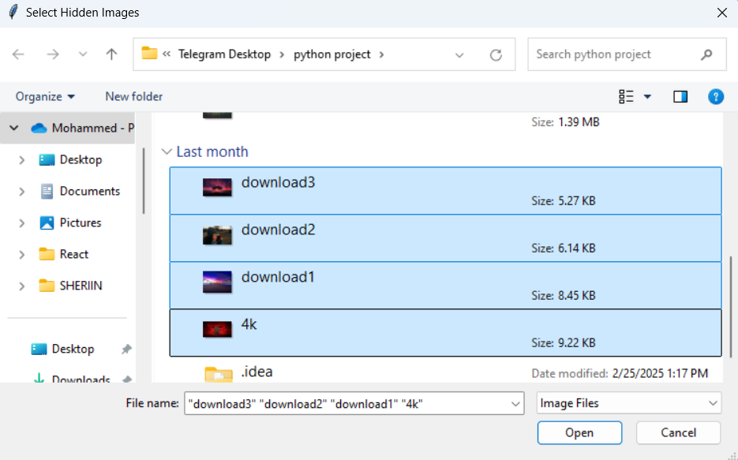
Screen Shots
Select Carrier and Hidden Images

Slide 25
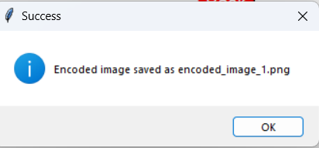

Screen Shots
Successfully Embedded images and saved Encoded image

Slide 26
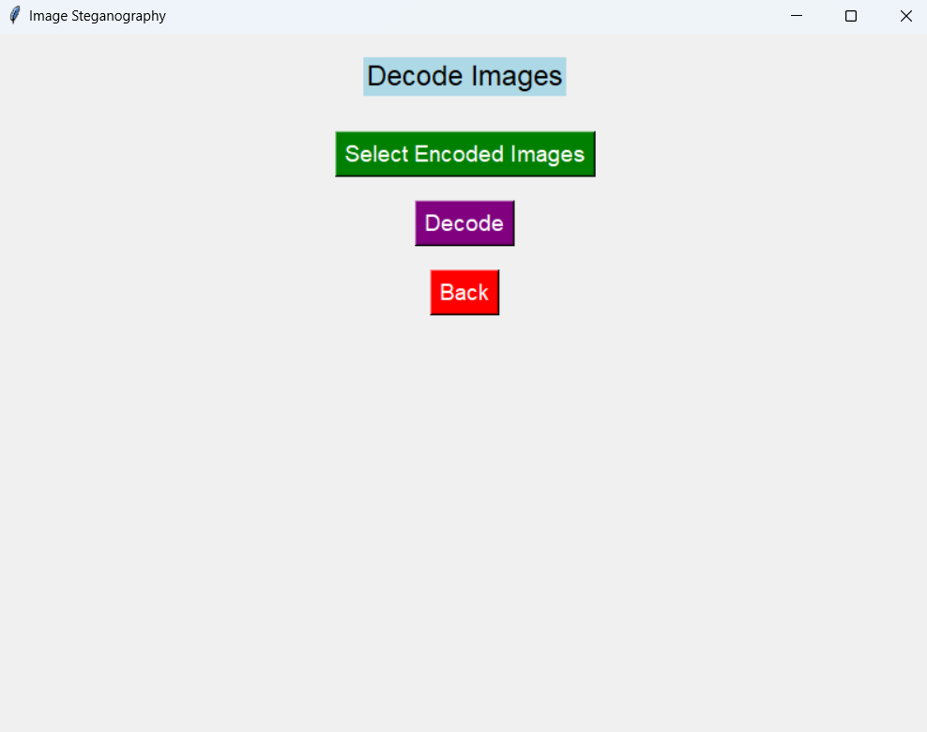
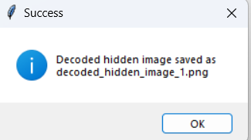
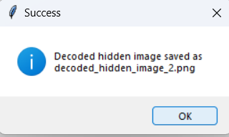
Screen Shots
Decoding Interface

Slide 27
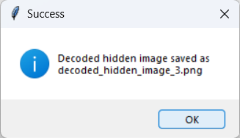
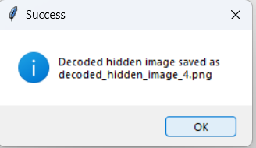
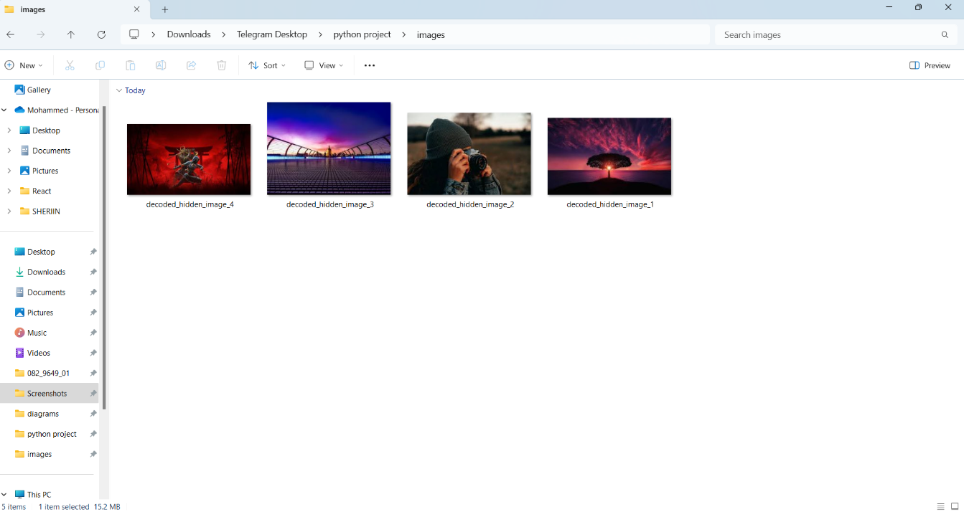
Screen Shots
Successfully extract images and Saved

Slide 28


Screen Shots
PSNR, MSE and Accuracy for original image and encoded image
PSNR, MSE and Accuracy for original image and decoded images

Slide 29
Conclusion
The LSB-based steganography system developed in this project provides a robust, efficient, and secure solution for hiding and retrieving data within digital images.
By leveraging Least Significant Bit (LSB) encoding, the system ensures minimal distortion to the carrier image, maintaining its visual integrity while embedding significant amounts of hidden data.
Innovative features such as error correction, metadata integration, and support for high-resolution images enhance its robustness and accuracy, enabling the system to withstand transformations like compression, resizing, and noise addition.
The user-friendly graphical interface ensures accessibility for both technical and non-technical users, while the system’s computational efficiency supports real-time applications such as secure communication and data protection
This project demonstrates the potential of steganography in advancing secure data hiding technologies and provides a strong foundation for future enhancements, such as embedding multiple images or incorporating encryption for added security.

Slide 30
Feature Enhancement
Integration of Advanced Encryption: Incorporate encryption algorithms such as AES or RSA to secure the hidden data before embedding, providing an additional layer of protection against unauthorized access.
Dynamic Embedding Techniques: Develop adaptive algorithms that dynamically select optimal bits for embedding, improving imperceptibility and resilience against various transformations.
Mobile and Cloud-Based Integration: Develop a mobile application or cloud-based platform for users to access the system remotely, enabling real-time secure data embedding and retrieval.
Real-Time Video Steganography: Expand the system to handle video files, allowing the embedding of hidden data in frames of a video stream, opening up new applications in secure multimedia communication.
Artificial Intelligence for Embedding Optimization: Utilize AI-based models to optimize embedding processes, improving efficiency and ensuring better imperceptibility and robustness.
Support for Additional File Formats: Extend compatibility to include more carrier formats, such as JPEG and TIFF, to enhance versatility while preserving image quality.

Slide 31
Reference Paper/ URL
JiaWei Hu ,“Image Steganography based on improved LSB algorithm” in *2024 39th Youth Academic Annual Conference of Chinese Association of Automation (YAC)*, Wuhan , China, 2024. DOI: 10.1109/YAC63405.2024.10598763
Vaibhavi Sushil , Dr Shashank Srivastav ,” A Data Safety Approach Based on Image Steganography ” in * 2023 International Conference on IoT, Communication and Automation Technology (ICICAT) *, 2023. DOI: 10.1109/ICICAT57735.2023.10263742
Manoj Kumar Sharma, Nidhi Bansal, Suraj Malik, Gaurav Kumar, Archana Jain , “A New Method of Image Steganography Technique Based on Fingerprint with Qr-Code Using Watermarking Technique ” in * 2023 3rd International Conference on Advancement in Electronics & Communication Engineering (AECE) *, 2023. DOI: 10.1109/AECE59614.2023.10428537
Muhammad Adman Aslam, Muhammed Rashid, Farooque Azam, Muhammad Abbas, Yawrar Rasheed, Saud S Alotaibi, Muhammed Waseem Anwar , “Image Steganography using Least Significant Bit (LSB) ” in *2022 2nd International Conference on Computing and Information Technology (ICCIT) *, January 2022. DOI: 10.1109/ICCIT52419.2022.9711628
Shashank Srivastav, Pradeep Kumar Singh, Divakar Yadav, “A Method to Improve Exact Matching Results in Compressed Text using Parallel Wavelet Tree ” in November 2021. DOI: 10.12694/scpe.v22i4.1870.

Slide 32
Conference / Publication / Patent Certificate/ Project Contest Winner Certificates
Slide 27

